Slide 1


Cloaked Therapeutics, LLC
Using the Body’s Own Mechanisms
To Transform Chemotherapy
TumorSelect® Technology
TumorSelect® Paclitaxel

Slide 2
Cloaked Therapeutics, LLC
TumorSelect® is a Chemotherapeutic drug delivery technology
  Targets tumors
  More effective tumor kill
  Will greatly reduce toxic side effects
Very solid intellectual property protection
  Drug substance and drug product
    Issued US patents
    Issued foreign patents

Slide 3
The Problem
The American Cancer Society estimates almost 2,000,000 new US cancer cases in 2021
Over 600,000 US cancer deaths in 2021 (Between March 2020 and now roughly 600,000 deaths from Covid-19)
Cancer chemotherapy is barbaric
Cancer chemotherapy is inadequately selective

Slide 4
Development Options
Discover and develop a new drug
  High risk
  10-12 years and $650 million
TumorSelect® paclitaxel
  Identify and develop a new delivery strategy
    LDL as a delivery mechanism
  Selectively delivered to tumors
  By choosing a well known clinically utilized drug (paclitaxel)we reduce risk of development failure
Notes:
Can have very selective action
$650 million to get to market
10-12 years
High risk, high reward
Focus of industry

Slide 5
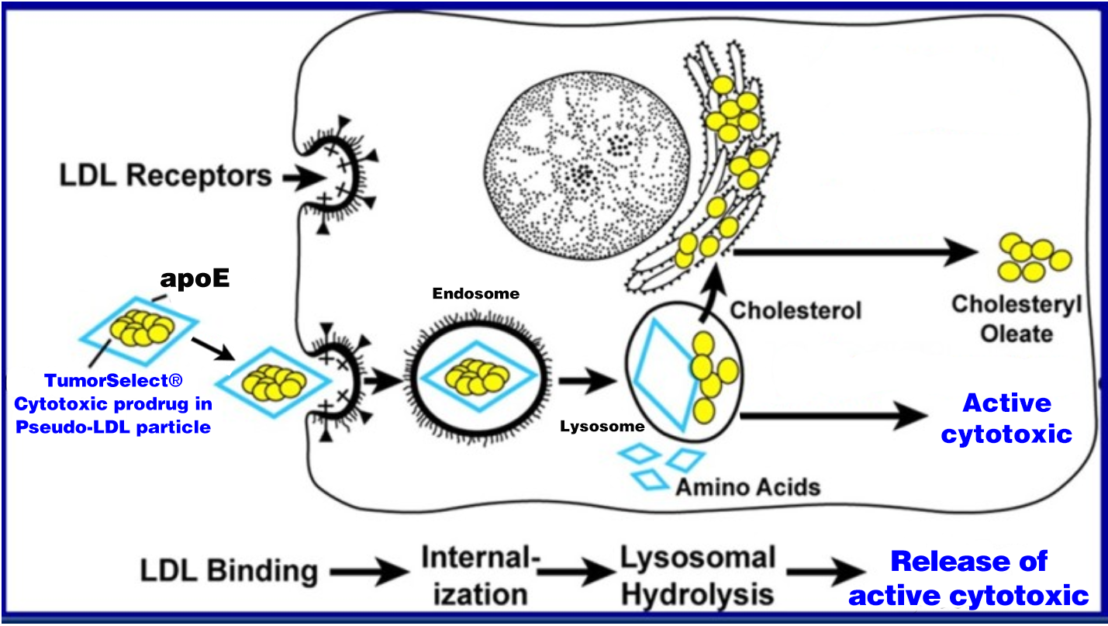
TumorSelect® LDL Mechanism

Slide 6
Four Questions to Be Addressed
Can a pseudo-LDL nanoparticle be created which is sufficiently similar to natural human LDL particles to be physiologically recognizable and stable enough to serve as a delivery vehicle for a cytotoxic payload?
Can a suitable paclitaxel derivative be prepared to be efficiently incorporated into and retained in the delivery formulation?
Does the proposed TumorSelect® construct of cytotoxic derivative and delivery vehicle improve TI of the cytotoxic and still retain efficacy?
Does the TumorSelect® technology selectively deliver cytotoxic to tumor tissue as proposed?

Slide 7
Can We Make Suitable Pseudo-LDL Particles?

Slide 8
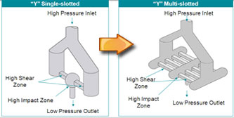
Pseudo-LDL Particles
Manufacturing
  MicroFluidizer®
    Process coarse emulsion
    Recirculating continuous flow
    Reduces particle size into desired range
    Has been scaled up by others to GMP-approved commercial scale
  Rational development of processing conditions
    Buffer composition
    Total solids content and composition
    Interaction-chamber geometry
    Temperatures
    Pressure

Slide 9
A Suitable Lipophilic Derivative of Paclitaxel to incorporate and be retained in the pseudo-LDL nanoparticle

Slide 10
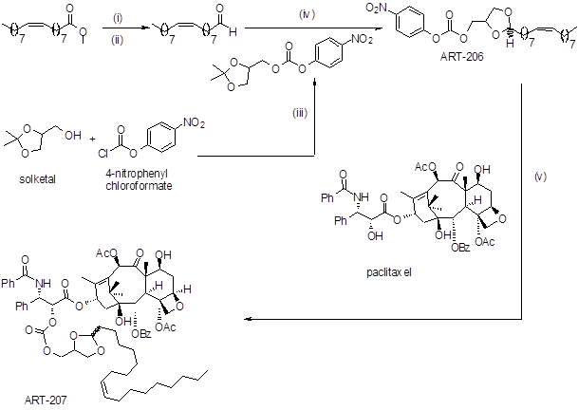
A Suitable Derivative to Incorporate

Slide 11
TumorSelect® Paclitaxel Lysosomal Release

Slide 12
Does the Construct of the Cytotoxic Drug and Delivery Formulation Retain Efficacy and Improve TI?

Slide 13
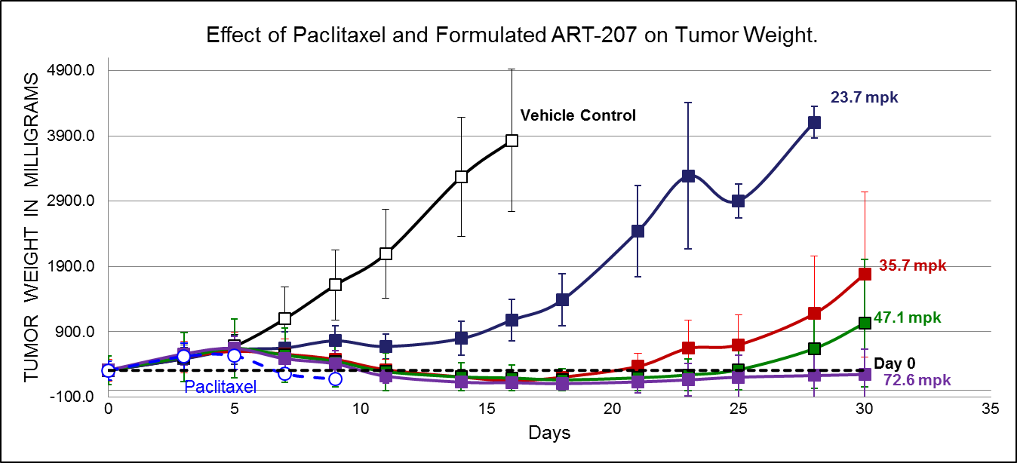
Dose Response Study in Murine Model of Human Breast Cancer
Mice were divided into 6 groups (5 mice in each group). All test articles were administered to mice for the five consecutive days via intravenous (iv) injections. Group #1 received drug-free lipid formulation ([0], open squares) and groups 2-5 received 23.7, 35.7, 47.1, and 72.6 mg/kg of formulated ART-207 (filled squares). Group #6 received 15 mg/kg of Cremophor EL/EtOH paclitaxel (open circles). Each point on the curves represents mean mouse weight assessed for each drug and vehicle treated group at the day of assessment (indicated in graph). The mean group cutoff is two animals per group. Effect is expressed as % of mean mouse weight assessed for each group prior to the first treatment at Day 0.

Slide 14
TumorSelect® Paclitaxel vs Taxol® Mouse Weight
Mice were divided into 6 groups (5 mice in each group). All test articles were administered to mice for the five consecutive days via intravenous (iv) injections. Group #1 received drug-free lipid formulation ([0], open squares) and groups 2-5 received 23.7, 35.7, 47.1, and 72.6 mg/kg of formulated ART-207 (filled squares). Group #6 received 15 mg/kg of Paclitaxel (open circles). Each point on the curves represents mean mouse weight assessed for each drug and vehicle treated group at the day of assessment (indicated in graph). Tumored mouse weight was corrected on the weight of tumor. The mean group cutoff is two animals per group. Effect is expressed as % of mean mouse weight assessed for each group prior to the first treatment at Day 0. Four of 5 mice died of toxicity in the paclitaxel group before day 10.

Slide 15
Pancreatic Growth Comparison to Abraxane®
MIA-PaCa-2 (ATCC, Manassas, VA) was implanted in NOD scid (NSG) female mice, and the animals were dosed with TumorSelect® paclitaxel with a comparison positive control of Abraxane®

Slide 16
Do We obtain Tumor Selective Delivery?

Slide 17
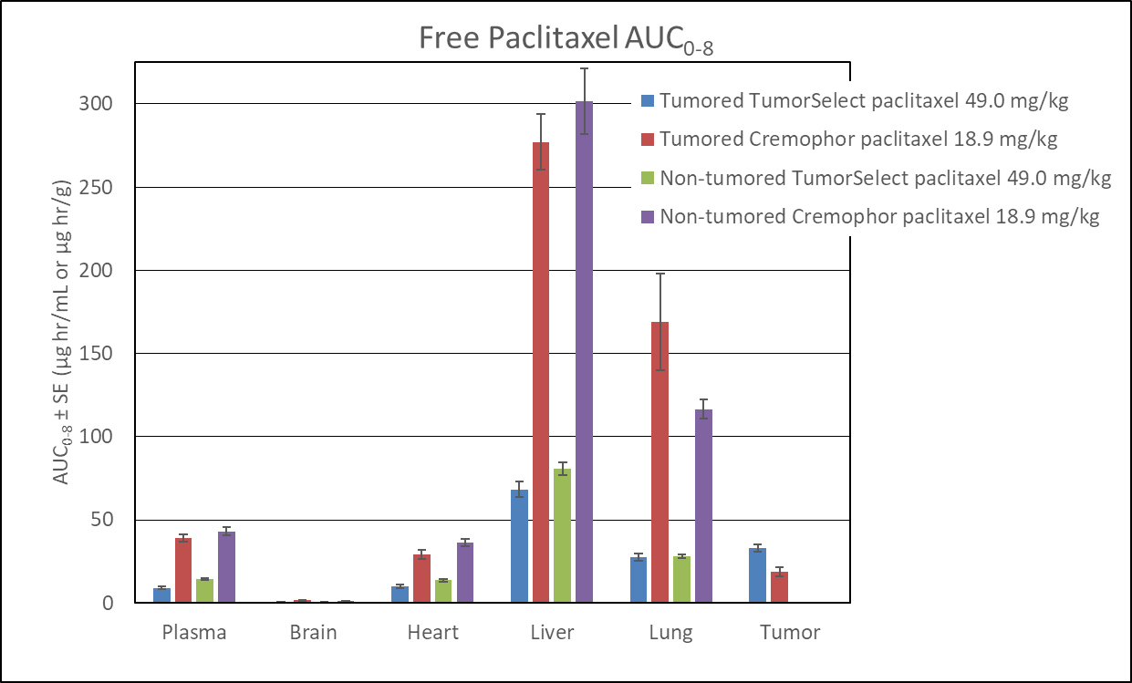
TumorSelect® Paclitaxel vs Cremophor®/EtOH Paclitaxel Single Bolus Injection

Slide 18
Delivery Efficiency of TumorSelect® Paclitaxel
Over 480 minutes, the delivery efficiency of total TumorSelect® paclitaxel is 4.8-fold higher than that of Cremophor®/EtOH paclitaxel

Slide 19
TumorSelect® Paclitaxel vs Taxol® Volume of Distribution
Non-tumored Animals:
  TumorSelect® paclitaxel 88 mL/kg
  Taxol® paclitaxel 658 mL/kg
Tumored Animals:
  TumorSelect® paclitaxel 97 mL/kg
  Taxol® paclitaxel 567 mL/kg
  N.B. TumorSelect® paclitaxel remains in the vasculature and does not indiscriminately distribute the toxic chemotherapeutic to normal tissues and organs as does Taxol®

Slide 20
TumorSelect® Paclitaxel vs. Taxol®
Overall TumorSelect® paclitaxel toxicity, efficacy and PK data show:
  Tumor growth suppression
  Less toxicity allows higher dose intensity
  Slower tumor regrowth / increased duration of efficacy
  Increased survival
  Higher number of tumor-free animals
  Significantly lower concentrations of paclitaxel in non-target tissues
  Significantly higher concentrations of paclitaxel in tumor tissue
  The time-averaged delivery (intact prodrug plus free paclitaxel) is 3.27% of the prodrug dose at 480 minutes

Slide 21
TumorSelect® Paclitaxel vs. Taxol® Summary
Data demonstrate targeted drug delivery and support LDL-receptor dependent mechanism of selective cellular uptake by tumor tissue of TumorSelect® formulated paclitaxel

Slide 22
The Future of Clinical Practice
Clinical practice for the foreseeable future will continue to rely on cytotoxic chemotherapy with hundreds of thousands of patients treated annually.
It is clear from published studies, such as the NEJM atezolizumab plus Abraxane® in triple-negative breast cancer study, that traditional chemotherapy will remain a mainstay of cancer treatment for the foreseeable future.
In particular, there is evidence that taxanes can potentiate immunotherapy.

Slide 23
Conclusion
Enhanced Patient Benefit
TumorSelect® technology represents a major improvement in the clinical treatment of cancer through enhanced efficacy due to tumor-facilitated targeted delivery and reduced patient toxicity with its associated deleterious side effects
Reduction of side-effect toxicity of cancer therapy by our technology will improve patient quality of life, patient retention in treatment regimes, more rapid patient recovery post treatment, and overall patient benefit.

Slide 24
Contact Information
Email
  jmcchesney@tumorselect.com
Phone/text:
  1-303-808-4104

Slide 25
Thank you for your attention.
Questions????

