Slide 1
AÇAÍ EXTRACTS AND BOTANICAL SUPPLEMENTS: POTENTIAL CYP INDUCTION-BASED
BOTANICAL-DRUG INTERACTIONS
McDonald K¹, Heck K¹, Salamat J², Dupre M¹, Dennis C¹, Keeton C¹, Almy M¹, Pondugula S², & Calderón AI¹
¹ Drug Discovery & Development, Harrison College of Pharmacy
²Department of Anatomy, Physiology, and Pharmacology, College of Veterinary Medicine
2023 Student Symposium
March 28, 2023
ICSB 2023
Oxford, MS
April 25, 2023

Slide 2
BACKGROUND: AÇAÍ
Euterpe oleracea Mart. (commonly known as açaí)
Traditionally used to treat various ailments (diabetes, malaria, fever, and liver disease).
Now is among the top 40 botanicals used in the US.
Due to its antioxidant and anti-inflammatory properties, many patients using prescription medications may use açaí supplements.
Concerns with botanical-drug interactions due to polypharmacy:
Açaí-drug interactions could occur due to effects on:
1) CYP enzymes
2) drug transporters (P-gp and OATP-1B1/1B3)
This study aims to evaluate how açaí extracts affect CYP induction and drug transporters in primary human hepatocytes.
Notes:
Each year, more açaí food products and botanical supplements are being used.

Slide 3
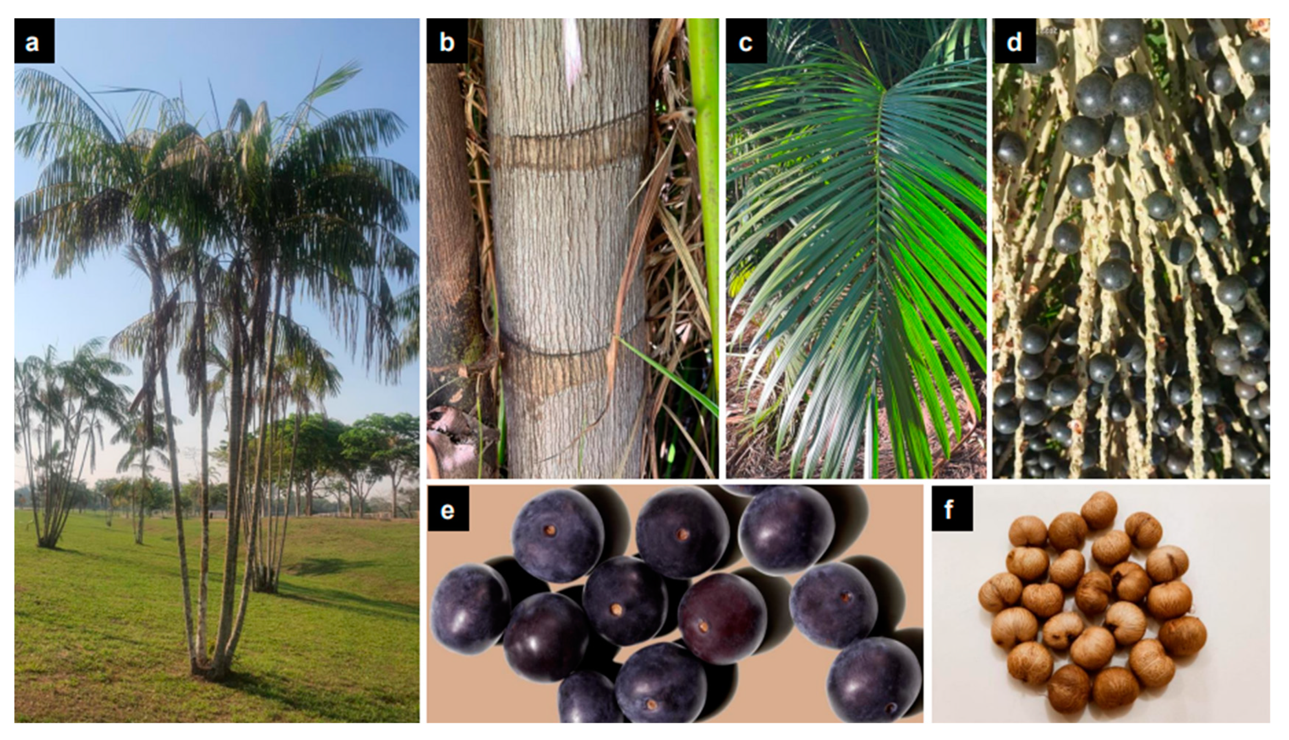
Laurindo, et al., Nutrients, 2023.
Notes:
Plant PARTs - fruit
Figure 2. Photographs of various parts of E. oleracea. (a) whole plant; (b) stem; (c) leaf; (d) panicles of fruits; (e) isolated fruits; and (f) isolated seeds.
Phytochemicals:
Fruit = polyphenols, anthocyanins, proanthocyanins, other flavonoids

Slide 4
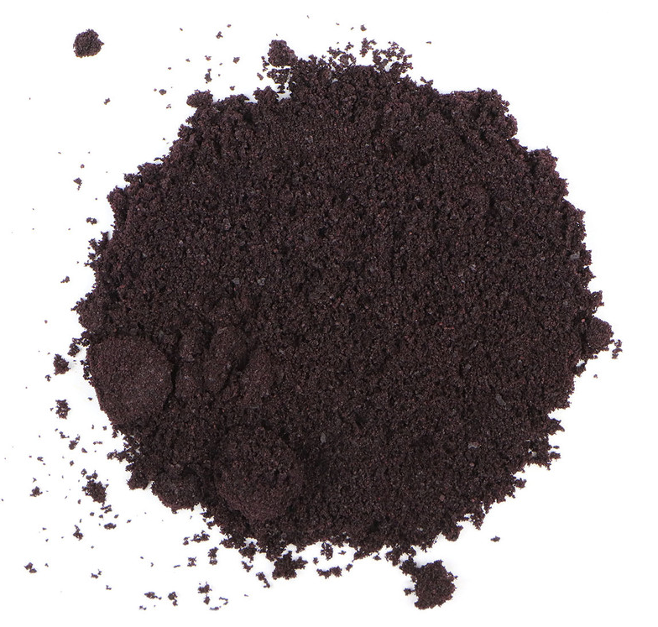
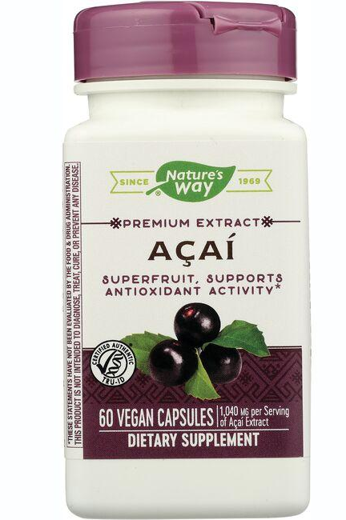
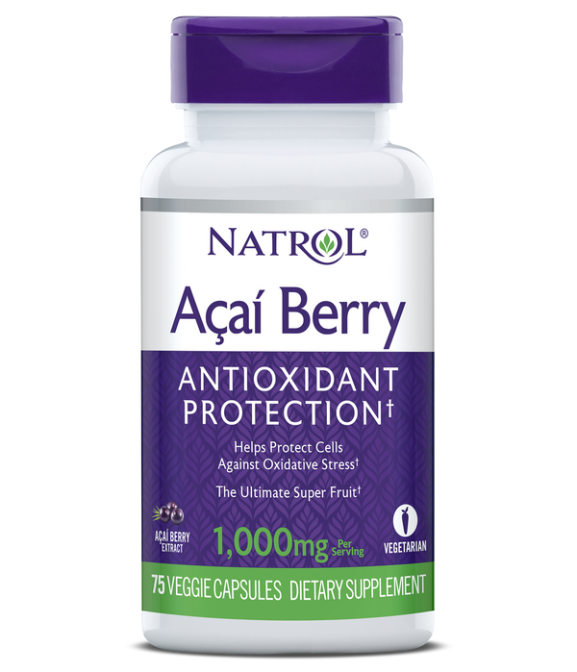
AÇAÍ EXTRACTIONS
Certified açaí berry power (Mountain Rose Lot #26579 = MR)
Verification performed by Alkemist Labs (Costa Mesa, CA, USA)
* high performance thin-layer chromatography through comparison to reference samples.
Nature’s Way (Green Bay, WI, USA)
lot #20099227 = F3
Acidic Methanol (AC) (MeOH:H2O 70:30, 0.1% HCl v/v)
Methanol (ME)
95% Ethanol (ET)
Natrol (Chatsworth, CA, USA)
lot #2070593 = F4
Water (AQ)
24-hour extractions (75 rpm at 25°C) at powder/solvent ratio = 40 g/L
Notes:
Organic extractions were performed twice, while aqueous extraction was performed only once to avoid the risk of microbial contamination. The extracts were filtered with Whatman filter paper no. 1, and all extracts were rotary evaporated and nitrogen dried before lyophilization except for aqueous extracts which were lyophilized only

Slide 5
AÇAÍ EXTRACT STANDARDIZATION
Utilizing our sample preparation and method from Heck, et al., Journal of Food Composition and Analysis, 2023, we then standardized our extracts to Cyanidin-3-O-Glucoside (C3G) concentrations via LC-MS QTOF analysis.
In vitro analysis: Human Relevant C3G concentrations screened.
Cmax value of 2.321 ng/mL in clinical study
- Mertens-Talcott, et al, J Agric Food Chem, 2008
Notes:
In-vitro assessment at [HED] C3G

Slide 6
PREVIOUS DATA
Açaí is a natural product containing known bioactive compounds,
including polyphenols, anthocyanins, proanthocyanins, and other flavonoids.
Effect on CYP transcription or expression is unknown.
Our lab has previously published data: 1) Concomitant use of anti-cancer drugs and açaí =
increase in reported vascular adverse events (AEs)
(Fahim, et al., Expert Opinion on Drug Safety, 2019)
2) Açaí compounds found to induce and inhibit CYP3A4
(Zhang, et al., Phytomedicine, 2019)
Notes:
Based on previous literature:
FAERS database – identified vascular AEs with concomitant açaí and anti-cancer drug use, which are metabolized by CYP3A4
(Fahim, et al., Phytomedicine 2019)
Found compounds in açaí induce CYP3A4.
(Zhang, et al., Phytomedicine 2019)

Slide 7
HYPOTHESIS
Reported in the literature:
AEs with concomitant use of non-CYP3A4 mediated anti-cancer drugs
OATP drug transporters are potential mediators of anti-cancer drugs
Some anti-cancer drugs have been found to inhibit drug transporters
Hypothesis: In primary human hepatocytes, açaí extracts will:
1) induce CYP mRNA
2) induce drug transporters
Utilized our sandwich-cultured primary human hepatocyte assay to determine:
Potential cytotoxicity
Potential induction of CYP mRNA (CYP3A4, CYP2B6, and CYP1A2)
Potential induction of drug transporters (P-gp, OATP-1B1, and OATP-1B3)

Slide 8
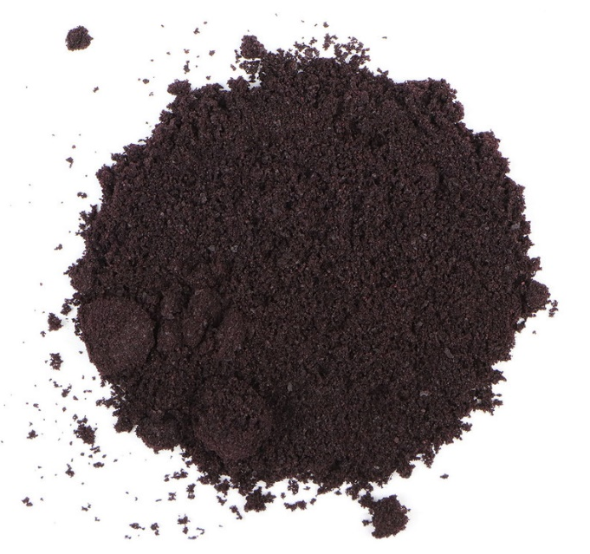
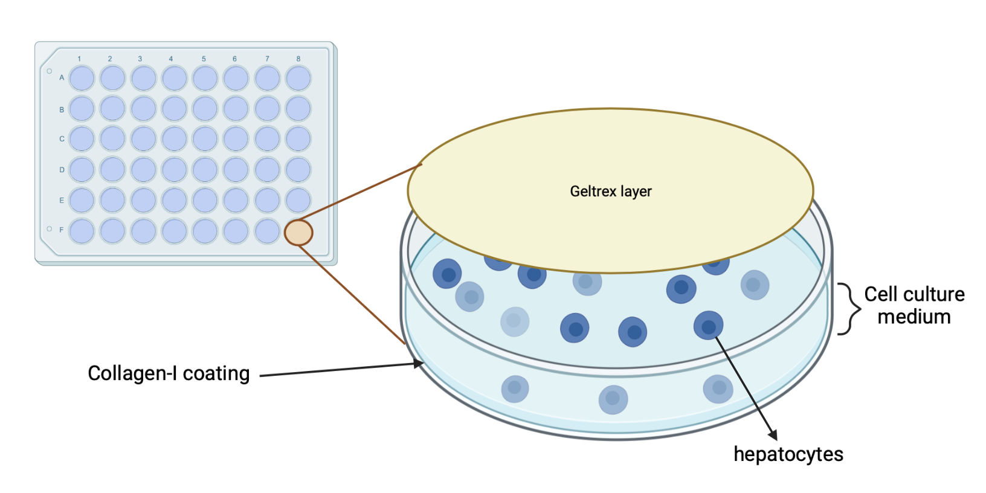
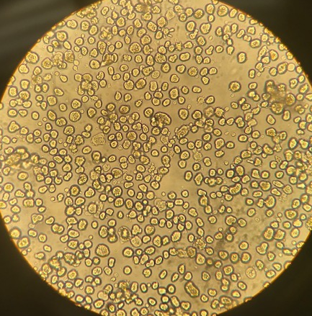
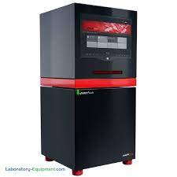
Induction Assay
Açaí extracts (MRAQ, MRAC, MRET, MRME, F3AC, F4AC, F4ME)
Dissolved in 85% H₂O : 15% ACN
Sterile filtered
Thaw hepatocytes and determine viable cell count with Trypan Blue
Dilute in medium and evenly disperse in 48-well Collagen-I plate
Treatment of sandwich-cultured primary human hepatocytes (SHCC) with controls or samples at 37°C for 24 hours
Total RNA extraction and isolation
Hepatocyte cells viewed under compound light microscope
RNA-to-Ct kit used to directly analyze via qPCR and measure fold induction of CYP mRNA
Positive controls: 20μM rifampicin (CYP3A4 & P-gp)
2mM phenobarbital (CYP2B6)
50µM omeprazole (CYP1A2)
No known inducers for OATP-1B1 and OATP-1B3
Analytik-Jena Q3 Tower Q-PCR Thermocycler
Vehicle control: 85% H₂O:15% ACN in medium

Slide 9
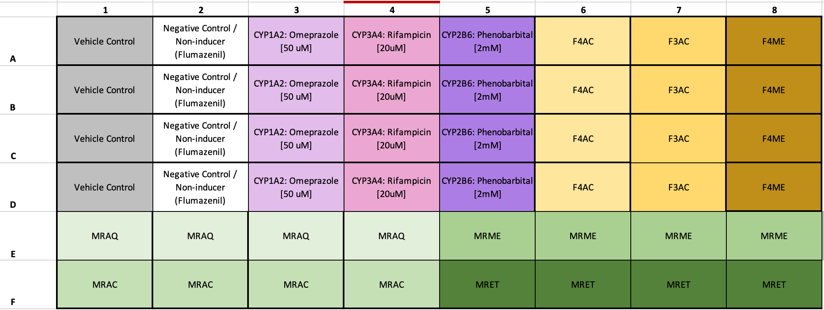
48-WELL ANALYSIS
Single-donor primary human hepatocytes (BioIVT – lot #RAS): 58-year old caucasian male
No prescription medications. No illicit drug use. No regular tobacco use. Light social drinker.

Slide 10
HUMAN RELEVANT CONCENTRATION: CYTOTOXICITY
Donor #RAS – (48-wells; sandwich-cultured hepatocyte assay)
2.321 ng/mL C3G concentration
Unpublished data, 2023

Slide 11
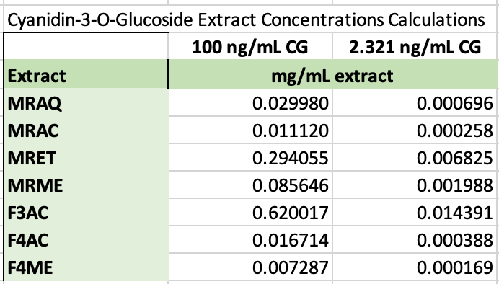
ANALYSIS AT HIGHER C3G CONCENTRATION
143 açaí (sole ingredient) supplements were identified.
Daily doses ranged from 25.5 mg – 6000 mg of açaí extract.
We further tested a 100 ng/mL C3G concentration, which is within this range of doses in our açaí extracts.
Notes:
Started at higher dose of 100ng/mL C3G concentration
When divided by total amount of water in human body at 42 L

Slide 12
AÇAÍ: DOSE-DEPENDENT CYTOTOXICITY
Donor #RAS – (48-wells; sandwich-cultured hepatocyte assay)
Dose – dependent cytotoxicity noted with F4AC = Acidified Methanol extract of Natrol botanical supplement
Unpublished data, 2023
Notes:
F4AC = dose-dependent effect
MRAC, MRME, and MRET = time-dependent effect

Slide 13
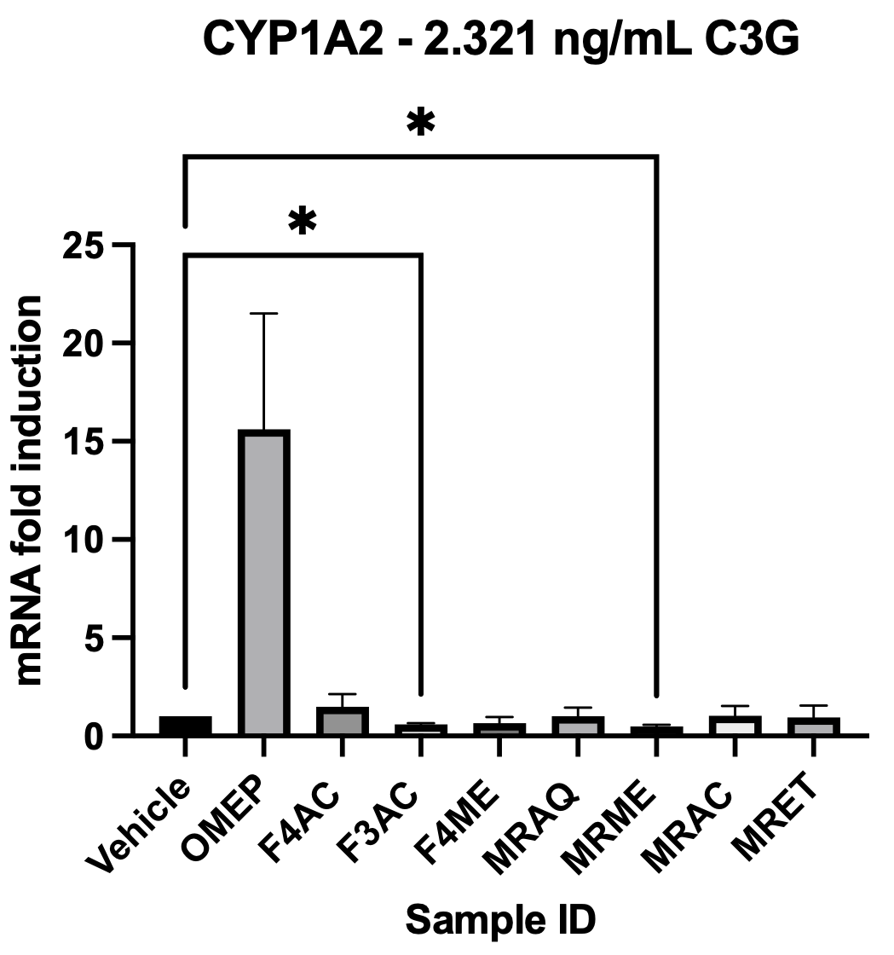
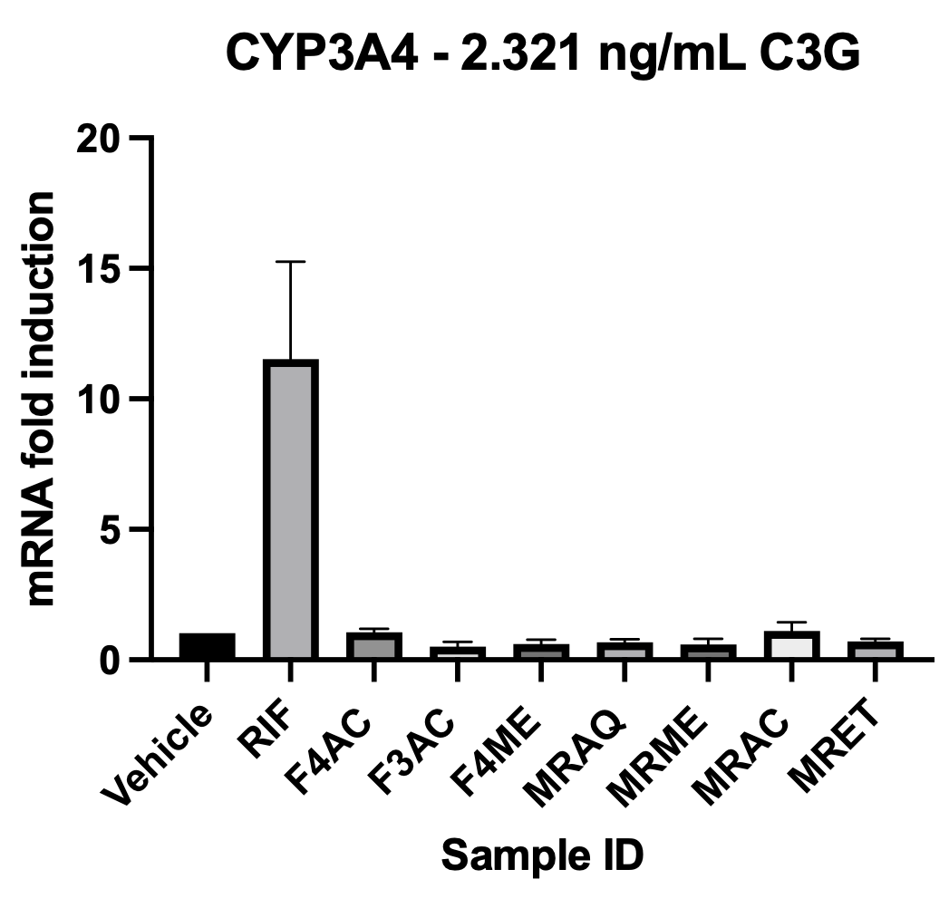
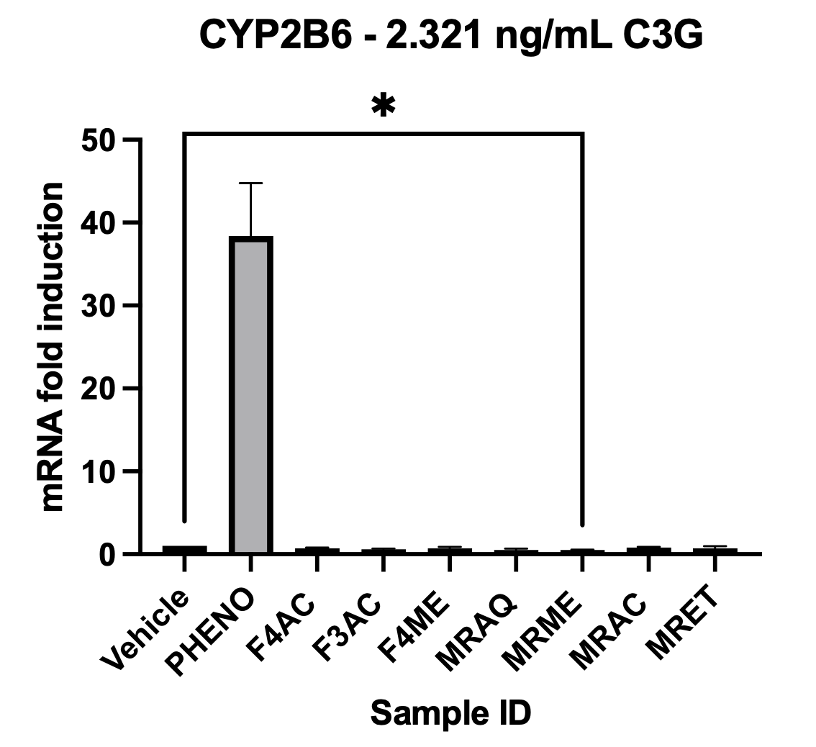
HUMAN RELEVANT CONCENTRATION: NO mRNA INDUCTION
Donor #RAS – (48-wells; sandwich-cultured hepatocyte assay)
FDA DDI guidelines: Significant induction =
>2-fold mRNA increase
>20% of known inducer
With Mountain Rose methanol extract (MRME) treatment, reduced mRNA production is noted for both CYP2B6 and CYP1A2.
Unpublished data, 2023
Notes:
3 CYPs that are most reported as being inducible in the literature.

Slide 14
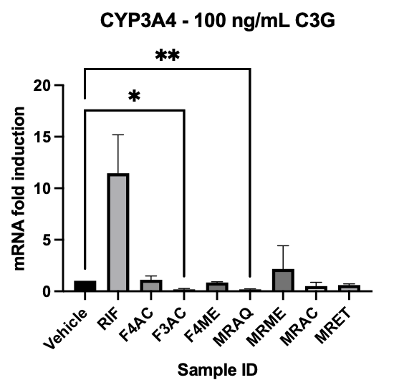
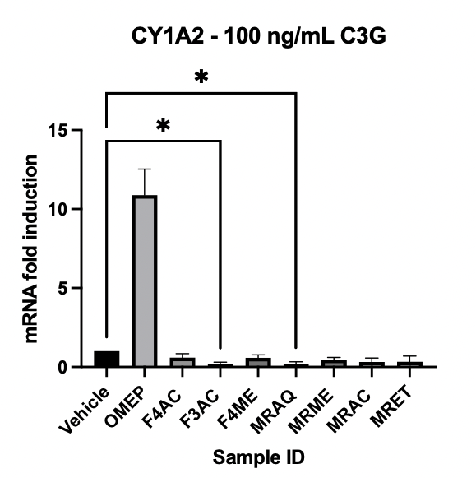
CYP3A4 AND CYP1A2 DECREASED mRNA AT 100 ng/mL C3G
Donor #RAS – (48-wells; sandwich-cultured hepatocyte assay)
p-value <0.05 = *
p-value <0.01 = **
Significantly reduced mRNA production of CYP3A4 and CYP1A2 with 100 ng/mL C3G concentrations of Nature’s Way acidic methanol extract (F3AC) and Mountain Rose aqueous extract (MRAQ).
** Many anti-cancer drugs are metabolized by CYP3A4. **
Unpublished data, 2023
Notes:
3 CYPs that are most reported as being inducible in the literature.

Slide 15
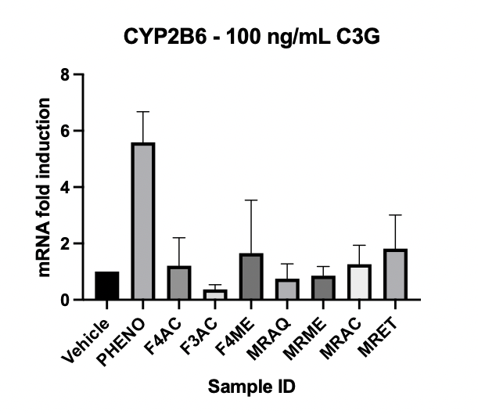
NO SIGNIFICANT mRNA EFFECT ON CYP2B6
Donor #RAS – (48-wells; sandwich-cultured hepatocyte assay)
Unpublished data, 2023
Notes:
3 CYPs that are most reported as being inducible in the literature.

Slide 16
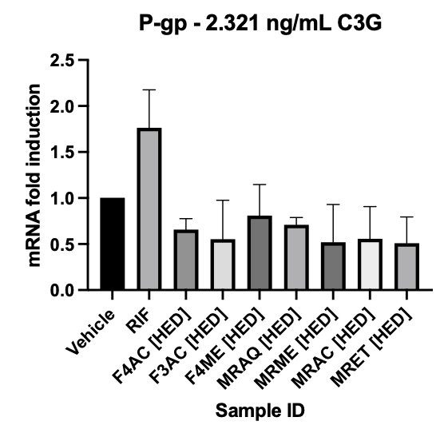
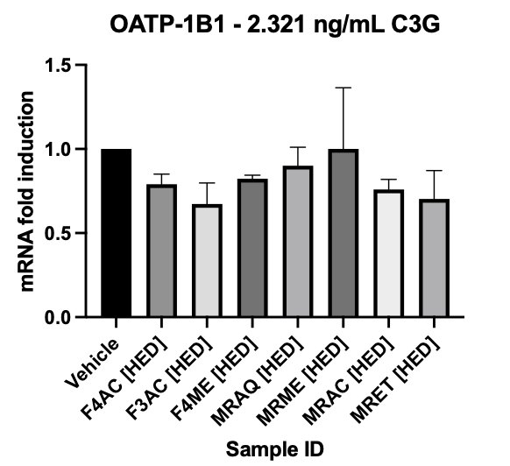
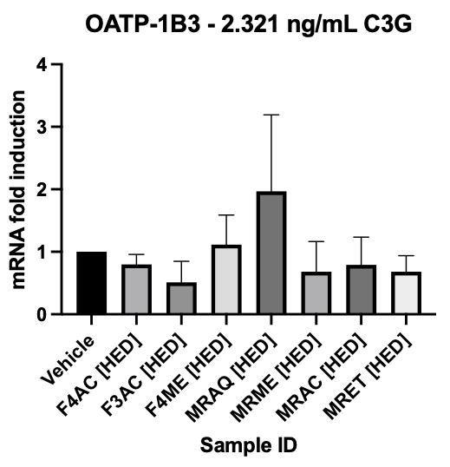
HUMAN RELEVANT CONCENTRATION:
NO INDUCTION OF DRUG TRANSPORTERS
Donor #RAS – (48-wells; sandwich-cultured hepatocyte assay)
At 2.321 ng/mL C3G concentration:
No induction of drug transporters (P-gp, OATP-1B1, OATP-1B3)
Unpublished data, 2023

Slide 17
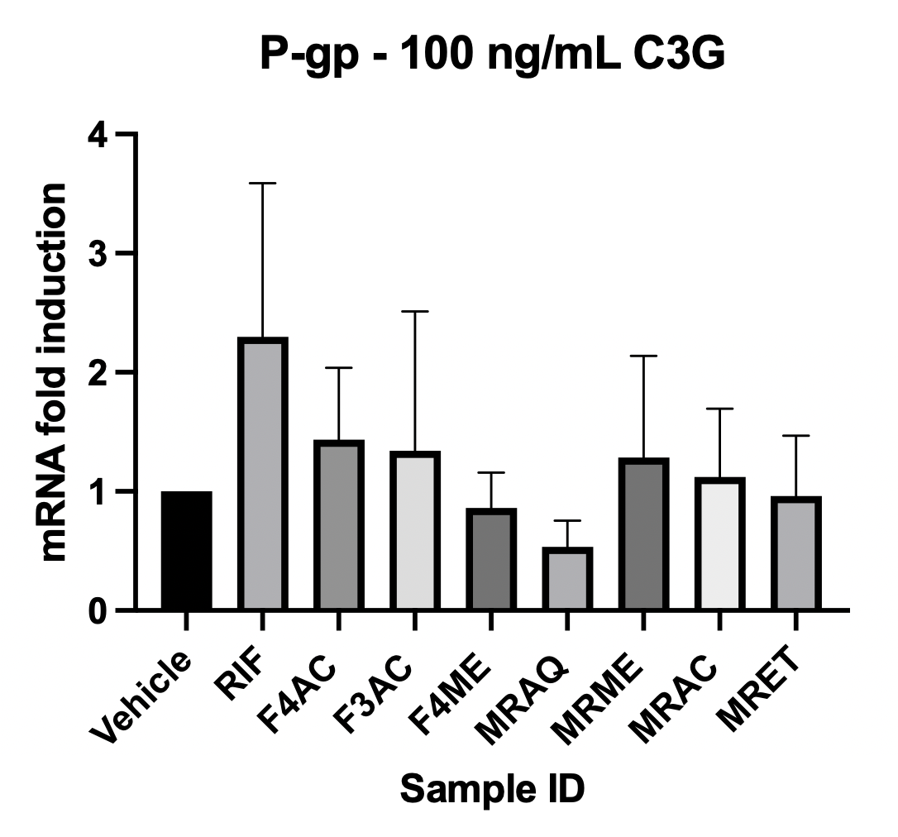
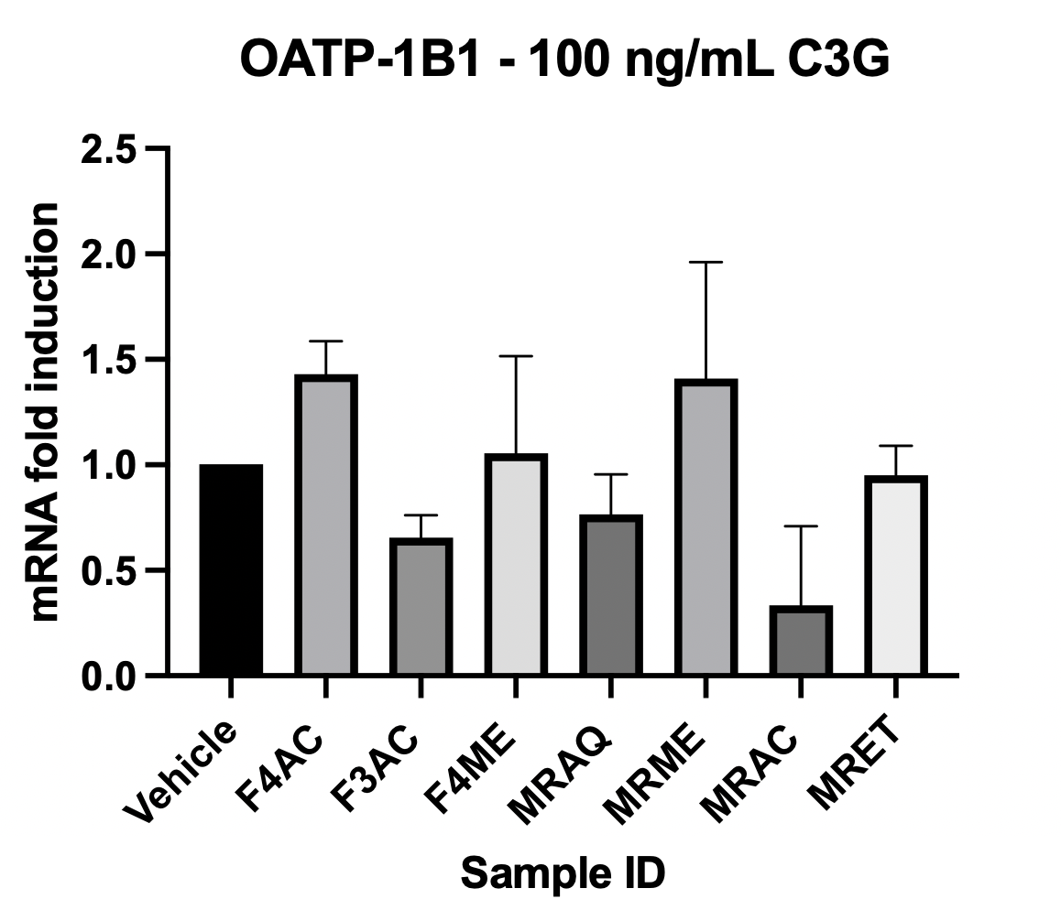
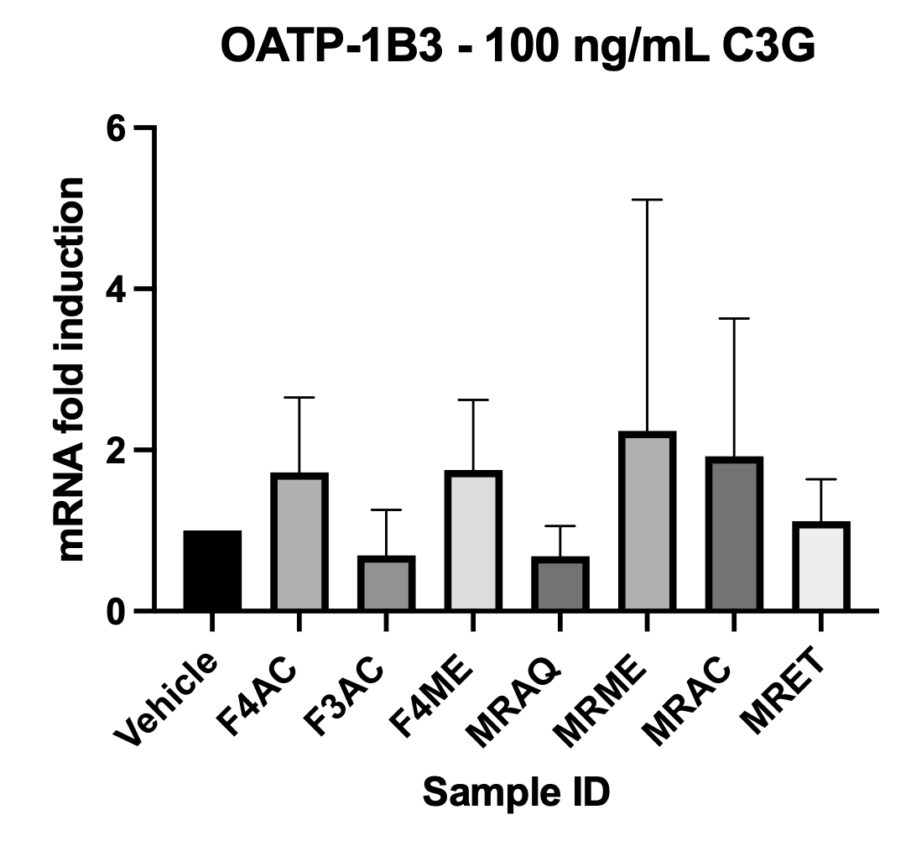
INCREASED CONCENTRATION:
NO INDUCTION OF DRUG TRANSPORTERS
Donor #RAS – (48-wells; sandwich-cultured hepatocyte assay)
At 100 ng/mL C3G concentration:
No induction of drug transporters (P-gp, OATP-1B1, OATP-1B3)
Unpublished data, 2023
Notes:
(blue rectangles) Note: Although F4AC was the only acai extract to show cytotoxicity at the 24-hour treatment timepoint, it did produce > Vehicle mRNA levels for all 3 transporters. This extract may produce induction of transporters when tested with a shorter treatment period.

Slide 18
SUMMARY
At Human Relevant Concentrations:
Time-dependent cytotoxicity noted with MRAC, MRME, and MRET.
At the higher botanical dose of 100 ng/mL C3G:
Concentration-dependent cytotoxicity noted with F4AC.
No concentration-dependent cytotoxicity noted with other açaí extracts.
Significantly reduced mRNA production of CYP3A4 and CYP1A2 with F3AC and MRAQ.
No induction of tested CYP enzymes or drug transporters noted.

Slide 19
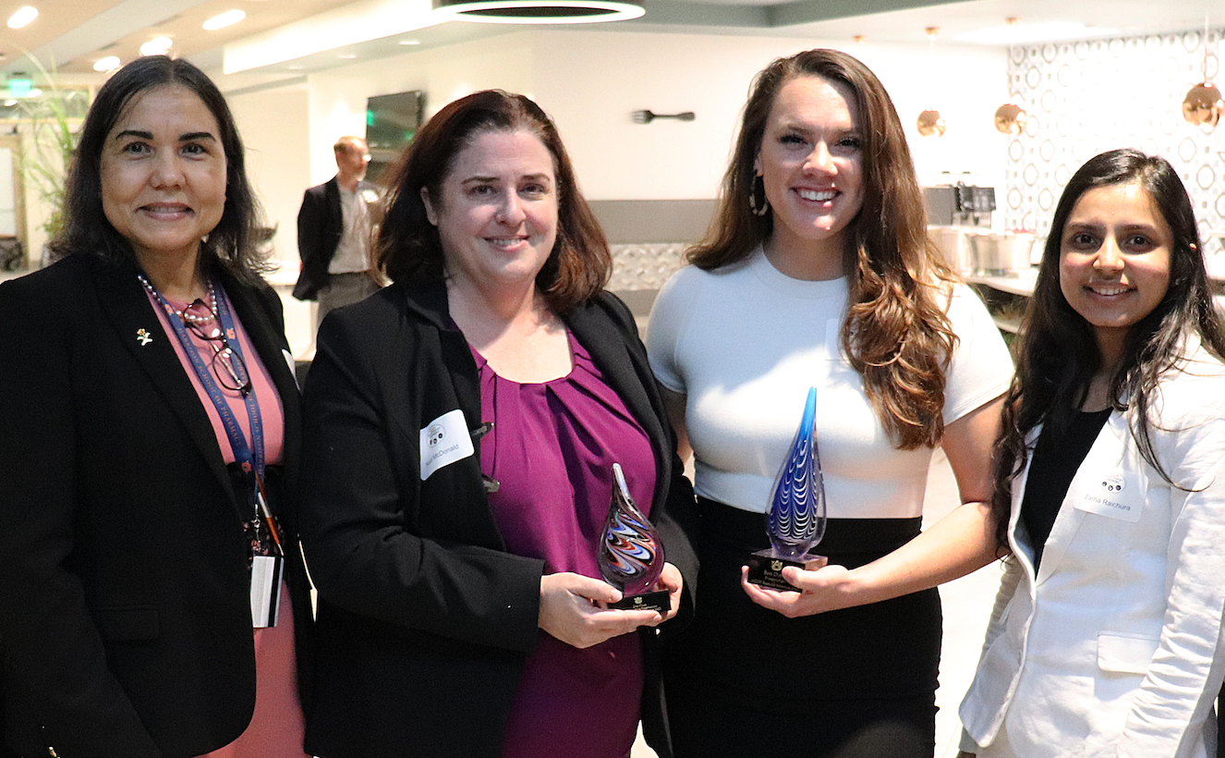
Acknowledgements
Dr. Angela I. Calderón
(PI; Department of Drug Discovery and Development)
Department of Anatomy, Physiology, and Pharmacology:
Dr. Satyanarayana R. Pondugula and Julia Salamat
Fellow GRAs and Undergraduate Students
This project was made possible by Grant Number R15AT011047 from the National Center for Complementary and Integrative Health (NCCIH) and the Office of Dietary Supplements (ODS). Its contents are solely the responsibility of the authors and do not necessarily represent the official views of the NCCIH, ODS, or the National Institutes of Health.

