Slide 1
The University of Mississippi
NSF Graduate Research Fellowship Program (GRFP)
Information Sessions
JUL 15, Jul 21, 2021
Jason Hale, M.S., Director of Research Development, ORSP
Robert Doerksen, Ph.D., Associate Dean of the Graduate School
Vivian Ibrahim, Ph.D., Associate Professor of History; Director of the Office of National Scholarship Advisement
with Annette Kluck, Nikki Reinemann-Gross, Thomas Werfel, Cole Stevens, Courtney Roper, Rachel Greenspan, & Hoang V. Le

Slide 2
Housekeeping
Mute your audio (until recognized to speak)
Share Video if comfortable, bandwidth permitting
Raise your Hand if you would like to speak
Use Chat to ask questions in the meantime
Those with answers may type them into the chat as we go.
Other questions will be answered at the end of the session, or following the session
The slides (and possibly the recording) will be available by month’s end at https://egrove.olemiss.edu/research_presentations/

Slide 3
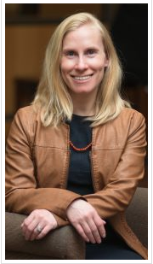
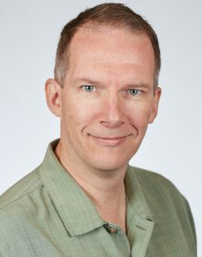
Welcome from Graduate School
Annette Kluck Dean
Robert Doerksen
Associate Dean

Slide 4
Info Session Goals
Understand what GRFP Fellowships are
General idea of how, where, and when to apply
Learn how NSF will evaluate your application
Hear from GRFP experienced UM Faculty
Get tips on making a competitive application
Learn about UM’s $200 incentive for applying
Start thinking abt/sharing your proposal ideas
Identify your questions, show you where to find answers and additional information & support
Learn if eligible & if your field of study qualifies

Slide 5
What are GRFP fellowships?
Graduate fellowships (scholarship) funded by NSF
Investments in YOU!
Bets on the future U.S. STEM workforce.
Provides financial support for 3 years of graduate school
For students in research-based STEM graduate programs and qualifying STEM research topics
Very student-driven and flexible
vs. typical “graduate assistantships” (faculty or department driven)
Very prestigious, and competitive
~16% of applications are awarded
Honorable Mentions for meritorious, but unawarded, applications are still significant national achievements!

Slide 6
What GR Fellowships Offer?
Five Year Award – $138,000
3 years of support towards graduate study (over 5 years)
$34,000 Stipend per year
$12,000 Educational allowance to institution
For tuition, fees, and other educational expenses
Flexible choice of project, advisor, & program
Portability to any accredited institution located in the US to pursue Master’s or Ph.D. degree

Slide 7
How many GRFP fellowships?
For the 2020 competition, NSF received over 13,000 applications and made 2,076 fellowships offers. https://www.nsfgrfp.org/applicants/
For the 2021 competition, NSF offered fellowships to 2,074 applicants. Another 1,830 received Honorable Mention.
You can look them all up here: https://www.research.gov/grfp/AwardeeList.do
For the 2022 competition (this year), 2,500 awards are expected!

Slide 8
Who led in GRFP awards last yr?
Zoom Poll
Harvard
Georgia Tech
MIT
Stanford
UC Berkeley
Univ. of Colorado, Boulder
Univ. of Washington
If you participated in last week’s session, please sit this poll out ☺

Slide 9
Who led in GRFP awards last yr?
Harvard: 47
Georgia Tech: 45
MIT: 66
Stanford: 81
UC Berkley: 83
Univ. of Colorado, Boulder: 39
Univ. of Washington: 37

Slide 10
Who led in SEC GRFPs last yr?
Zoom Poll
LSU
Texas A&M
Vanderbilt
U. of Alabama
U. of Arkansas
U. of Florida
U. of Georgia
U. of Kentucky
U. of South Carolina
U. of Tennessee
If you participated in last week’s session, please sit on your hands ☺

Slide 11
Who leads in GRFP in the SEC?
LSU: 7
Texas A&M: 15
Vanderbilt: 11
U. of Alabama: 3
U. of Arkansas: 5
U. of Florida: 20
U. of Georgia: 9
U. of Kentucky: 6
U. of South Carolina: 4
U. of Tennessee: 4

Slide 12
Who led in SEC GRFPs last yr?
LSU: 7
Texas A&M: 15
Vanderbilt: 11
U. of Alabama: 3
U. of Arkansas: 5
U. of Florida: 20
U. of Georgia: 9
U. of Kentucky: 6
U. of South Carolina: 4
U. of Tennessee: 4
U. Mississippi: 3
MSU: 3
Auburn: 2
Missouri: 2

Slide 13
Does UM Punch above our Weightclass?
LSU: 7
Texas A&M: 15
Vanderbilt: 11
U. of Alabama: 3
U. of Arkansas: 5
U. of Florida: 20
U. of Georgia: 9
U. of Kentucky: 6
U. of South Carolina: 4
U. of Tennessee: 4
SEC University | Enrollment
Texas A & M University-College Station | 68,726
University of Florida | 52,407
University of Georgia | 38,920
The University of Alabama | 38,100
University of South Carolina-Columbia | 35,364
Louisiana State University and Agricultural & Mechanical College | 31,756
Auburn University | 30,460
University of Missouri-Columbia | 30,014
The University of Tennessee-Knoxville | 29,460
University of Kentucky | 29,402
University of Arkansas | 27,559
Mississippi State University | 22,226
University of Mississippi | 21,617
Vanderbilt University | 13,131
U. Mississippi: 3
MSU: 3
Auburn: 2
Missouri: 2
https://www.univstats.com/comparison/southeastern-conference/student-population/

Slide 14
GRFP Application Timeline
Late Oct or Early November Oct 29, 2021, 5 p.m. ET
July/August
Mid-late October Oct 18, 2021, 5 p.m. local
Solicitation Posted
Applications Due
Reference Letters Due
Recipients Announced
Acceptance of Award and Declaration of Tenure/Reserve
Fellowship Year Begins
March - April
May 1
June 1 or Sept. 1

Slide 15
How to Prepare and Submit
Solicitation has been posted soon to the NSF GRFP Program Page: https://www.nsf.gov/funding/pgm_summ.jsp?pims_id=6201
Provides the following information:
Deadlines
Program description
Award information
Eligibility requirements
Application preparation
Submission instructions
Application review criteria

Slide 16
GRFP Application
Complete an Application Package at research.gov:
Personal Information, Education, Work/Research Experience, Proposed Field of Study, Academic Honors, Publications
Personal, Relevant Background and Future Goals Statement (3 pages)
Graduate Research Statement (2 pages)
Transcripts (uploaded electronically)
Three letters of reference
See the most recent Solicitation for app. details & requirements.
Notes:
1. Personal info – do not assume your reviewers will know what abbreviations mean. Describe any awards or scholarships so reviewers will understand their importance. Your research experiences are super-important – make it clear whether a presentation is a poster or a talk or a paper, and whether a presentation is within your department, school, or at a conference, etc. Clarify your role in any collaborative projects. Make it clear what you contributed.

Slide 17
A competitive Personal Statement
3 pages max
Experiences (personal and professional) contributing to your motivation and preparation for pursuing a STEM career
Previous research/industrial/professional experiences
What was the project?
How did you become involved? Where was it done?
Why was this project worth doing?
What was your contribution to the project?
How did your part of the project fit into the whole?
What have you learned? Any advanced course work?
Career aspirations and future goals
How have your experiences shaped your goals?
Address NSF’s review criteria
Labeled Intellectual Merit section
Labeled Broader Impacts section

Slide 18
A competitive Research Statement
2 pages max
Describe your Research Plan
Communicate your research idea and approach
Explain your research plan and methods
What do you expect to learn?
How will you know if the project is successful?
What would you do next?
Address NSF’s review criteria
Labeled Intellectual Merit section
Labeled Broader Impacts section
Communicate clearly for non-specialists
Avoid jargon!
Make your contributions clear

Slide 19
Who are You?
2 minutes
Zoom Poll: Who are you?
What is your classification?

Slide 20
Review Process
All applications will be reviewed and rated holistically by disciplinary and interdisciplinary scientists and engineers, and other professional graduate education experts.
Know your audience. Write for your audience.

Slide 21
Standard NSF Review Criteria
Two National Science Board-approved review criteria:
Intellectual Merit
How important is the proposed activity to advancing knowledge within its own field or across different fields?
Why will other scientists care?
Broader Impacts
How well does the proposed activity benefit society or advance desired societal outcomes?
Why will other citizens care?
Notes:
Before we get to the two statements – personal and research – let’s look at the review criteria. This is what is uppermost in the reviewers’ minds when they’re reading your application. Make their jobs easy – make it clear how you and your research meet these criteria.

Slide 22
Intellectual Merit
Your potential to discover new knowledge
Demonstrated intellectual ability (grades, curricula, awards…)
Other evidence of your potential for scholarly scientific study, such as your ability to:
Plan and conduct research
Work as a member of a team as well as independently
Interpret and communicate research
Take initiative, solve problems, persist
The potential of your approach to advance your field of study and your Research Plan to lead to new knowledge
Notes:
Note that your intellectual merit is different from your research’s intellectual merit…

Slide 23
Broader Impacts
Your potential impact on society
Your research project’s potential impact on society: why it’s important
Societal benefits may include, but are not limited to:
Increasing participation of underrepresented groups: women, underrepresented racial or ethnic minorities, students w/disabilities, veterans
Education outreach: Mentoring; improving STEM education
Increasing public scientific literacy; increased public engagement with science and technology
Community outreach: science clubs, radio, TV, blogs
Potential to impact a diverse, globally competitive workforce
Increasing collaboration: academia, industry, others
Notes:
Likewise, your broader impacts are different from your research’s broader impacts.

Slide 24
Intellectual Merit & Broader Impacts
Evidence of intellectual merit can be found in all parts of the application - Personal Statement, Research Plan, letters, experiences, awards, achievements, transcripts.
Likewise, evidence of broader impacts can be found in all parts of the application - Personal Statement, Research Plan, letters, experiences, awards, achievements.
However, the both the Personal, Relevant Background, and Future Goals Statement, as well as the Graduate Research Plan Statement, must explicitly address Intellectual Merit and Broader Impacts under separate headings to help reviewers evaluate these criteria.

Slide 25
Additional GRFP Review Criteria
Applicants’ potential to advance knowledge and to make significant research achievements and contributions to their fields throughout their careers.
Reviewers are asked to assess applications using a holistic, comprehensive approach, giving balanced consideration to all components of the application, including the educational and research record, leadership, outreach, service activities, and future plans, as well as individual competencies, experiences, and other attributes.
The aim is to recruit and retain a diverse cohort of early-career individuals with high potential for future achievements, contributions, and broader impacts in STEM and STEM education.

Slide 26
Faculty Perspectives
Pause presentation. Faculty with GRFP experience can share their perspetives for 2-3 minutes eash.
Dr. Ibrahim to go last (more time), with tips for successful applications/services available from ONSA.

Slide 27
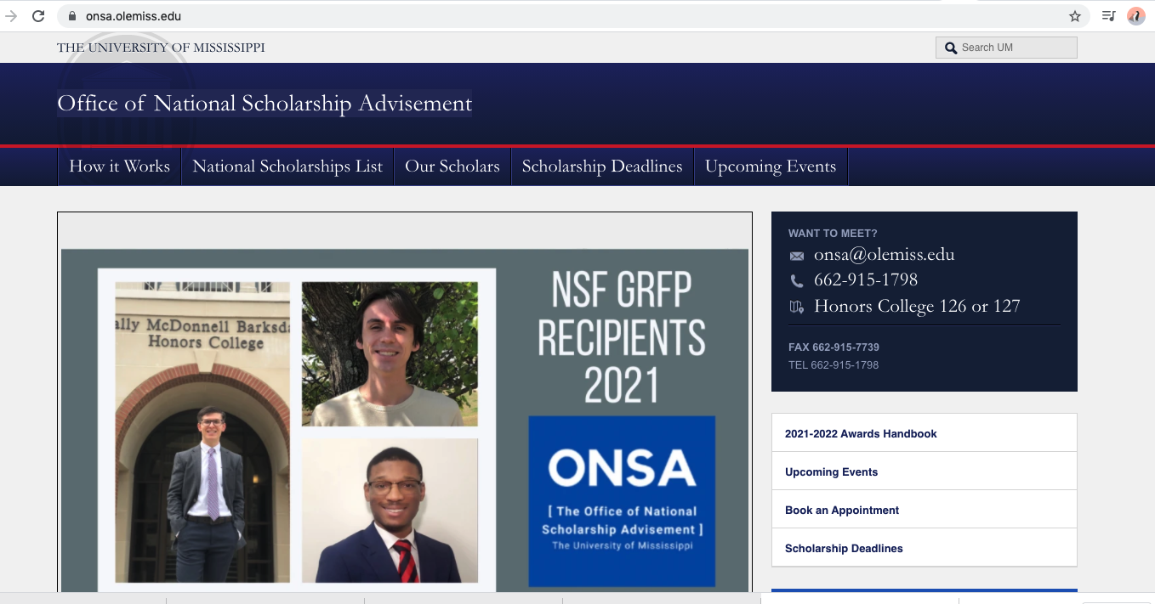
ONSA Perspectives & Services
Dr. Vivian Ibraham, vibrahim@olemiss.edu

Slide 28
InterActivity
8 minutes
Spend 5 full silent minutes considering at least ONE of these questions relative to your GRFP application (each person can decide which question)
What is a career goal you have?
What is a research idea or topic you’d like to explore?
What personal aspect might motivate your career, anchor your story?
What is a question you have about GRFP?
What weakness do you need to address (or what are you afraid of)?
What strength can you capitalize on (or what are you confident about)?
Think about how to state your answer in 5 or 10 words or so (but don’t share yet)
When I say “GO”:
Type one of your answers in the chat. OR
Raise your hand to be called on to share out loud.

Slide 29
GRF Ops Center
15 seconds
If in doubt whether your proposed program of study, or your proposed research topic, are considered SUPPORTED fields, contact the The Graduate Research Fellowship Operations Center.
The Graduate Research Fellowship Operations Center is responsible for responding to questions about the program.
For questions concerning eligibility and fields of study, contact the Graduate Research Fellowship Operations Center, (866) 673-4737, international (202) 331-3542, or info@nsfgrfp.org.

Slide 30
Who Else Can Assist?
Dr. Ibrahim: Will provide mentoring on undergraduate student applications as previously discussed.
Dr. Doerksen: Will review and provided feedback on any grad students’ personal statements and/or research statements received by October 1, 2021 (email rjd@olemiss.edu).
Jason Hale: Will review and provided feedback on any students’ personal statements and/or research statements received by Sept 1, 2021 (email jghale@olemiss.edu).
Others?

Slide 31
To Receive $200 Incentive
Submit your application on-time to NSF
Submit proof of NSF acceptance of application, and copy of submitted proposal, to Dr. Doerksen no later than November 15, 2021 (rjd@olemiss.edu)
A $200 scholarship will be awarded by the end of the fall semester

Slide 32
If Awarded…
ORSP and the Graduate School have developed a set of guidelines for GRFP awardees electing to conduct their fellowships at UM.
See https://gradschool.olemiss.edu/nsf-grfp

Slide 33
Changes in This Year’s Solicitation
This solicitation covers the Fiscal Year (FY) 2022 competition.
Applications must be submitted in Research.gov through the GRFP Application Module (https://www.research.gov/grfp/Login.do).
Applications are due at 5:00 p.m. local time of the applicant's mailing address.
In FY2022, NSF will continue to fund outstanding Graduate Research Fellowships in all areas of science and engineering supported by NSF and continue to emphasize high priority research areas in alignment with NSF goals and priorities (https://www.whitehouse.gov/wp-content/uploads/2021/04/FY2022-Discretionary-Request.pdf). Applications are encouraged in all disciplines supported by NSF.
Portions of the eligibility criteria have been rewritten for clarity.
Reference letters are due October 29 at 5:00 p.m. Eastern Time (ET).
Applicants and reference letter writers requiring accessibility accommodation are asked to notify the GRF Operations Center at least four weeks before the deadline to coordinate assistance with NSF in submitting the application or reference letter.

Slide 34
Rewritten Eligibility Criteria
Eligibility is based on the applicant's status at the application deadline.
Applicants must self-certify that they are eligible to receive the Fellowship. To be eligible, an applicant must meet all of the following eligibility criteria at the application deadline:
Be a U.S. citizen, national, or permanent resident
Intend to enroll or be enrolled full-time in a research-based master's or doctoral degree program in an eligible Field of Study in STEM or STEM education (See Appendix and Section IV.3 for eligible Fields of Study)
Have never previously accepted a Graduate Research Fellowship
If previously offered a Graduate Research Fellowship, have declined by the acceptance deadline
Have never previously applied to GRFP while enrolled in a graduate degree program
Have never earned a doctoral or terminal degree in any field
Have never earned a master's or professional degree (see joint bachelor's-master's degree information below) in any field, or completed more than one academic year in a graduate degree-granting program, unless (i) returning to graduate study after an interruption of two (2) or more consecutive years immediately preceding the application deadline, and; (ii) are not enrolled in a graduate degree program at the application deadline
Not be a current NSF employee

Slide 35
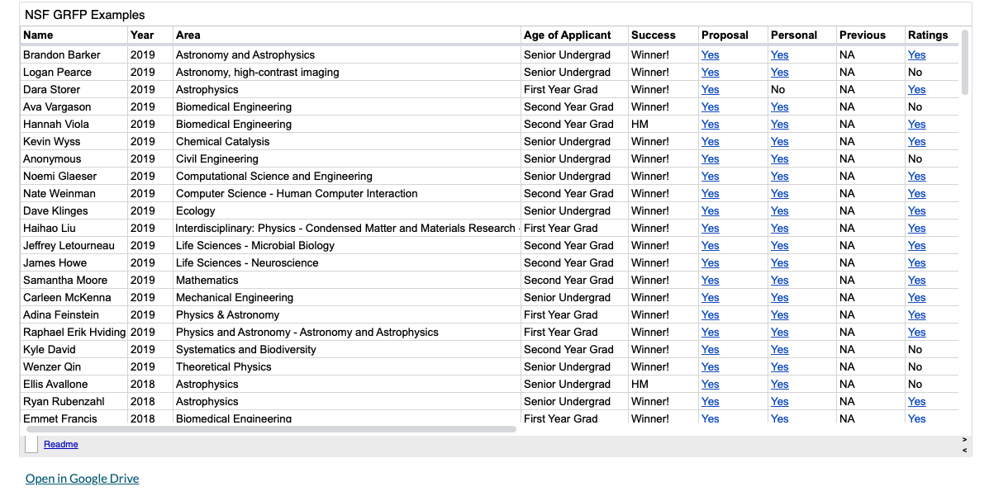
Examples of GRFP Proposals ?
https://www.alexhunterlang.com/nsf-fellowship
- UM ORSP cannot confirm whether all of these are legitimate or not, but you might want to take a look at some of them.

Slide 36
Q&A and Discussion

Slide 37
Good luck! The slides (and possibly the recording) will be available by months’s end at https://egrove.olemiss.edu/research_presentations/

Slide 38
Bonus/Extra Slides…

Slide 39
UM Faculty Perspectives

Slide 40
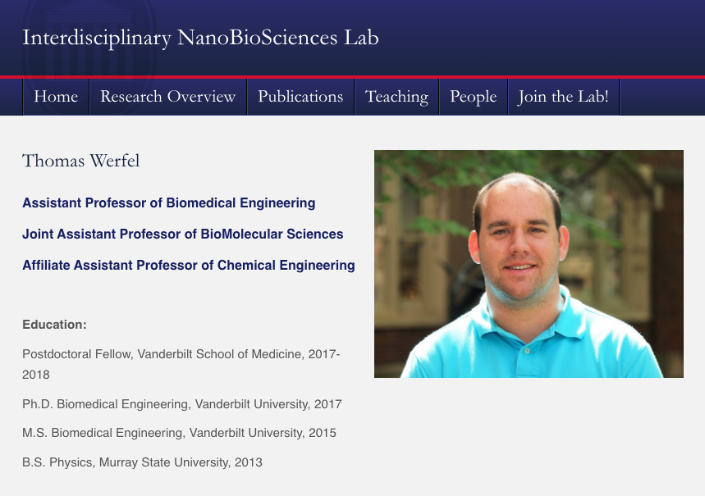
UM Faculty Perspectives

Slide 41
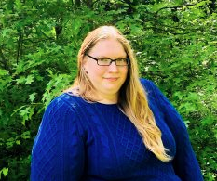
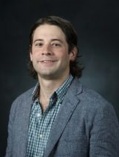
NSF GRFP Reviewer Perspectives
Cole Stevens
Assistant Professor of Pharmacognosy
stevens@olemiss.edu
www.stevenslab.com
Courtney Roper
Assistant Professor of Environmental Toxicology
clroper@olemiss.edu
courtneyroper.wixsite.com/roper

Slide 42
Past UM NSF GR Fellows
Johnathan Hill
Master of Arts Student in Teaching
Undergraduate Degree: Math, Jackson State University
Applied for GRFP in senior year
Amber Kay
Ph.D. Student in Pharmaceutical Sciences
Undergraduate: Biochemistry and Molecular Biology Mississippi State University
Applied for GRFP in senior year

Slide 43
Are You Eligible?
1 minute
U.S. citizens, nationals, and permanent residents
Early-career: senior undergraduates, baccalaureate recipients, or graduate students who have completed no more than ONE academic year of study at time of application
in Science, Technology, Engineering, or Mathematics (STEM)
To ACCEPT a fellowship offer, you must be accepted to a qualifying graduate program
Must (be) enroll(ed) in a full-time, research-based, M.S. or Ph.D. degree program in summer or fall of GRFP award offer year (not necessarily at the time of application).
Professional degree programs are NOT qualifying

Slide 44
GRFP Eligibility- Academic Levels
30 seconds
Academic Levels
Applicants compete against others from same Academic Level
1: Seniors or baccalaureate recipients with no graduate study 2: First-year graduate students.
3: 2nd-year grad students
4: More than 12 months of graduate study with an interruption of greater than 2 years (can have M.S. degree, but not terminal degree)

Slide 45
How often can you apply?
30 seconds
Only one application per person per annual competition
Academic Levels
1: Seniors or baccalaureates with no graduate study 2: First-year graduate students
3: Second-year graduate students
No restriction – can apply every year until enrolled in graduate school
Apply only once, in 1st or 2nd year
No more than one year of graduate study as of August 1 of the year the application is submitted

Slide 46
GRFP Fields of Study
20 seconds
Chemistry
Computer & Information Systems
Science/Engineering
Engineering
Geosciences
Life Sciences (includes Biological Sciences)
Materials Research
Mathematical Sciences
Physics and Astronomy
Psychology
Social Sciences (includes Economics)
STEM Education

Slide 47
NOT SUPPORTED
30 seconds
Joint science-professional degree programs
e.g. MD/PhD, JD/PhD
Business administration or management
Counseling, Social work
Education (except in science and engineering education)
History (except in history of science)
Research with primarily disease-related goals
Clinical research, patient-oriented research, epidemiological and behavioral studies, outcomes research, health services, public health research, focus on disease etiology and treatment

Slide 48
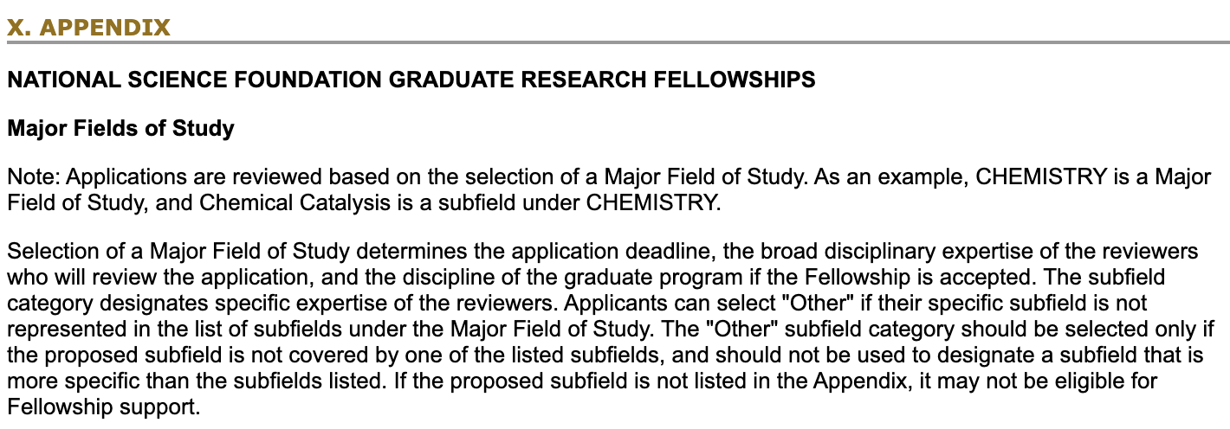
Not Sure about Your Field?
30 seconds
See Appendix at end of the NSF GRFP Solicitation
If your proposed subfield is not covered by the one of the listed subfields, it may not be eligible for GRFP.

Slide 49
Tips for a competitive application
Skip over this slide now?
Start early! Look at the NSF GRFP website (www.nsfgrfp.org).
Print, read, highlight, re-read, and refer often back to the latest NSF Solicitation in preparing your application.
Read the Frequently Asked Questions (FAQs) and call NSF if something is confusing to you
Describe your honors, experiences, presentations, and any publications (etc.) clearly for the reviewers.
Select and confirm your reference letter writers and monitor receipt of their letters on the GRFP website.
Share your application materials and the merit review criteria with your reference letter writers.
Pay attention to NSF’s merit review criteria.
Your statements should be interesting and clear. Ask several colleagues to read and comment on drafts.
Leverage existing UM GRFP experience!

Slide 50
GRF Winning Videos
The Secrets of Nitrogenase https://www.youtube.com/watch?v=vsiJT0UuHMg
Whales in Fjords
https://www.youtube.com/watch?v=S84GQL3IAjw
Sonic Reef https://www.youtube.com/watch?v=tBCmIG7zKmU

